Slide 1
Meta Clause Predictor(MCP)

Slide 2
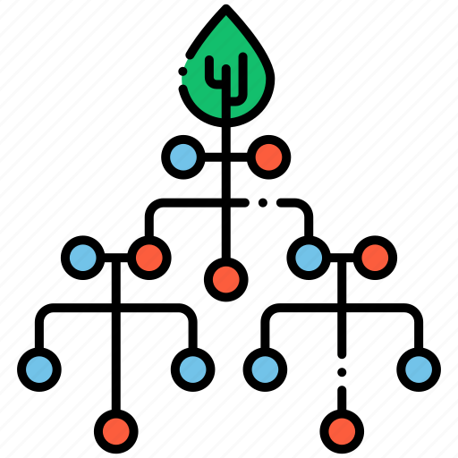
Process Flow :
Upload file to system
Splitting pdf to images
OCR Generation
Auto identification of MC
User verification
Output
Generation

Slide 3
What we use?
Front end : React js
Back end : Python
Framework : Flask
Database : MongoDB
Storage : GCP Bucket
ML Model : Random Forest Classifier

Slide 4
MCP Version 1.0 status
Pdf Upload
Splitting of pdf
OCR Generation
Meta clause identification using bag of words for each page
Display the meta clause in dashboard

